Slide 1
SOCIAL NETWORK SERVICES ON DECENTRALIZED SOCIAL NETWORKS: TEXT-BASED SERVICES
Created by : LE QUOC THANH
ID : ITIU09028
Advisor : MSc. VO DUY KHOI
March 12nd, 2014
Notes:
Good morning lady and gentlemen
Welcome to my thesis presentation about text-based service. A service on decentralized social networks.
Allow me introduce myself, My name is Le Quoc Thanh
Let’s follow me, you will know what this service is and how useful it is .

Slide 2
OUTLINE
Motivation
Problem Description
Existing Solutions
System Architecture Proposal
Demonstration
Conclusion and Future Works
Notes:
As u see on the slide, I’ve divided my presentation into 6 main parts:
Motivation, problem description, existing solutions, system architecture proposal, demonstration and lastly conclusion.
Let’s move to the Motivation

Slide 3
MOTIVATION
Two main types of services on social networks:
Text exchanging
Resource sharing
Disadvantages of client-server architecture:
Privacy issues
Storage issues
Propose a posting message services (text exchanging service) on decentralized social network to solves these problems
Notes:
Online social network as Facebook, Twitter has attracted millions users around the world .
There are 2 main types of services such as:
Text exchanging: users interact with each other by text as discussion posting message, chat. With some popular site as Facebook , Twitter.
Resource sharing: allows user to upload and share pictures, video. With some popular site as YouTube and Flickr.
Most of the available online social network are based on client-server architecture, which users’ social data are kept centralized. So, they are facing some issues as:
Privacy issues: users cannot manage the dissemination of their personal data by dependence on central provider’s administration.
Storage issues: faces to single point of failure, require large of servers and bandwidth to accommodate the growing number of users.
=> Hence, I propose a posting message service on decentralized social network to solves these problems.
- Let’s move to Problem Description.

Slide 4
PROBLEM DESCRIPTION
How to solve privacy issues on decentralized social network?
How to solve storage issues on decentralized social network?
What architecture suitable for posting message service on decentralized social network?
How to implement posting message service on decentralized social network?
Notes:
- A decentralized online social network is an online social network implemented on a distributed information management platform, such as a network of trusted servers or a peer-to-peer systems.
- Decentralized online social networks can solve problems of centralized infrastructure by three respects:
Privacy: users in decentralized social networks decide who to show their social data to and what restriction there is on the data.
Ownership: as the social data is stored on a trusted servers or on the local device that users have complete ownership of the data. They would not lose their data suddenly as the proprietary service hosting their data decides to shut down without much notice.
Dissemination: social data is disseminated according to users’ preferences and friendship relations.

Slide 5
EXISTING SOLUTIONS
1) Related works
PeerSoN:
resolve user privacy and connectivity
provide direct data encryption communication between network nodes
use distributed storage to foster local services
Tribler:
share file through existing social relationships
discover fast and recommendation of digital contents
Notes:
Firstly, Some academic research such as PeerSoN, Tribler as well as open source and free privacy started looking at decentralized architectures in recent years:
PeerSoN:
resolve user privacy and connectivity
provide direct data encryption communication between network nodes
use distributed storage to foster local services
Tribler:
share file through existing social relationships
discover fast and recommendation of digital contents
PeerSoN: resolves the problem of user privacy and Internet connectivity on social networks. It replaces the centralized authority of social networks and provides direct data communication between network nodes by using a P2P framework with encryption. It also use distributed storage to foster local services.
Tribler: based on purpose Social-based P2P File Sharing, which is basically a P2P content sharing system that leverages the existing social relationships and taste similarities among its users for fast discovery and recommendation of digital contents

Slide 6
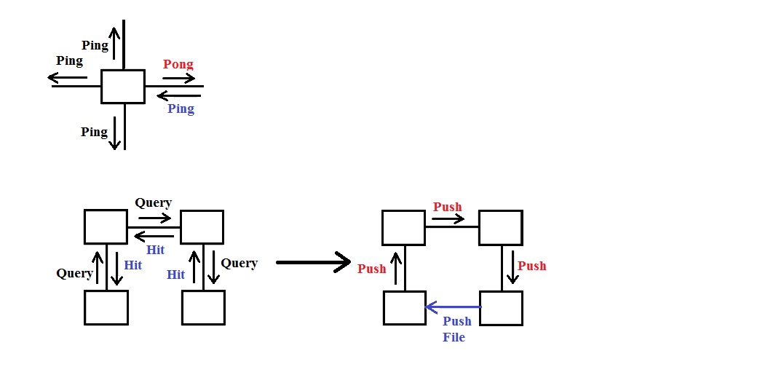
EXISTING SOLUTIONS
2) Gnutella protocol
support establishing the super peer P2P network
use unstructured and flooding-based protocol to provide flexible query processing
offer five types of messages:
Ping and Pong used to discover the network.
Query and Queryhit used to exchange data.
Push used to deal with peers behind the firewall.
Ping/Pong/ Query/QueryHit/Push Routing
Notes:
Secondly, we take time to consider Gnutella protocol. This is a protocol not an service or application.
support establishing the super peer P2P network.
use unstructured and flooding-based protocol to provide flexible query processing
offer five types of messages:
Ping and Pong used to discover the network.
Query and Queryhit used to exchange data.
Push used to deal with peers behind the firewall.

Slide 7
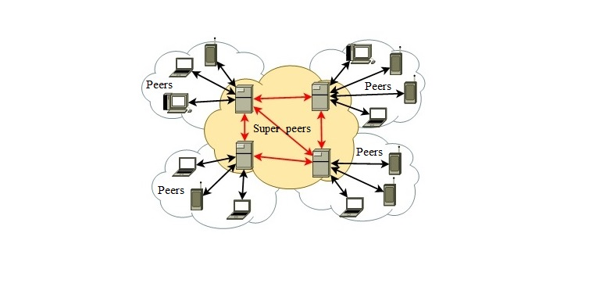
SYSTEM ARCHITECTURE PROPOSAL
1) Architecture
supported for proposing architecture of posting message service on the publishing research paper named “Peer-to-Peer Based Social Network [1]”, which exploring by Dr. Ha and MSc. Khoi.
Super peer P2P architecture
Notes:
This architecture supported for proposing architecture of posting message service on the publishing research paper named “Peer-to-Peer Based Social Network [1]”, which exploring by Dr. Ha and MSc. Khoi.
For peers, which can be desktop, laptop or mobile devices. Whereas, the super peers are only desktop or laptop because it needs not only strongly system resources and stable connectivity but also high uptime without being behind a firewall to execute many complex operations and stores large amount of data.
Each peer with normal system resources connects to some super peers, while super peers connect to other super peers.
Peers can become super peers if they have sufficient capability.

Slide 8
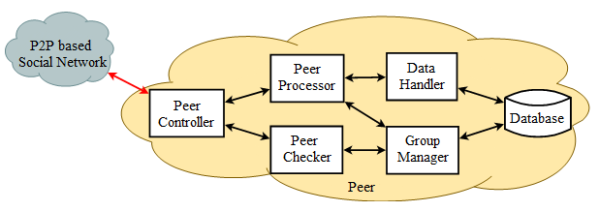
SYSTEM ARCHITECTURE PROPOSAL
2) Components inside peers
Peer Controller: manages communication and exchanges information among peers.
Peer Checker: takes a role of registration servers to authenticate peers.
Peer Processor: keeps tracks on peer activities related to the posting message service including message filter, newsfeed, search and user posting functions.
Data Handler: uses to update and store status messages on both peers and super peers.
Group manager: is responsible for group formation, manages and forwards user status messages.
Database: stores all record of user’s statuses and profile in the user’s device.
Peer components and communication
Notes:
Let’s consider components inside peers of this architecture that applied for posting message service.
Peer Controller: manages communication and exchanges information among peers.
Peer Checker: takes a role of registration servers to authenticate peers.
Peer Processor: keeps tracks on peer activities related to the posting message service including message filter, newsfeed, search and user posting functions.
Data Handler: uses to update and store status messages on both peers and super peers.
Group manager: is responsible for group formation, manages and forwards user status messages.
Database: stores all record of user’s statuses and profile in the user’s device.

Slide 9
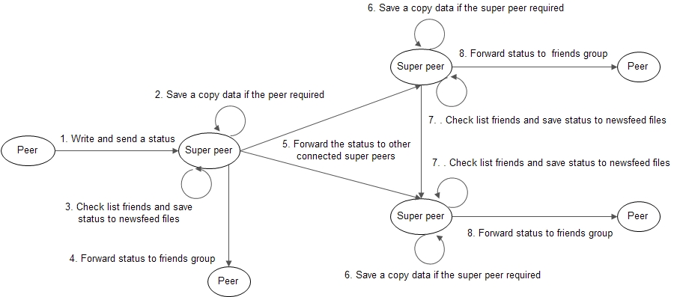
SYSTEM ARCHITECTURE PROPOSAL
3) Progresses in posting message service
a) Update user’s statuses progress
Notes:
Next, we consider 4 main progresses in this service:
Firstly, Update user’s statuses progress: used to distribute user’s social data on several super peers instead of one single server as client-server model, and forwards user’s statuses to their friends:
User writes a status on their home page and sent to connected super peer.
The Super peer will store a copy data into database if they are required.
Check whether list friends’ newsfeed files that friends are defined in the status, are storing in the super peers. If the super peer are storing these files, they will save the status into these files to help these friends can update the status. Otherwise, the super peer will send the status to other connecting super peers.
Super peer send the status to connecting users if they are in the friends group.
Super peer will send the message to defined friends group through other super peers.
6, 7, 8. In step 6, 7, and 8 are the same with step 2, 3, and 4 respectively.

Slide 10
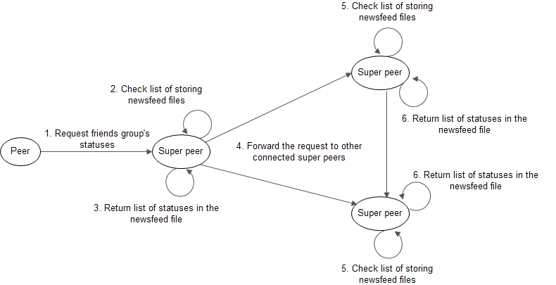
SYSTEM ARCHITECTURE PROPOSAL
3) Progresses in posting message service
b) Update friends group’s statuses progress
Notes:
Secondly, Update friends group’s statuses progress: uses to keep tracks their friends’ shared statuses , which are stored in their newsfeed file at super peers.
User sends a request to connecting super peer to update all of shared friends statuses.
Super peer receives the request and check list of storing newsfeed files to check whether requesting user’s data was storing at database.
After that, if the super peer are storing these data of requesting user, it will return a response message to the requesting user only including all of statuses in their newsfeed file. Inversely, if the super peer is not storing these data, step 4, 5 and 6 will be activated.
If the super peer is not storing these data, it will forward the request to other connecting super peers to help user keep tracks their friends’ statuses.
5, 6. In step 5 and 6 are the same with step 2 and 3 respectively.

Slide 11
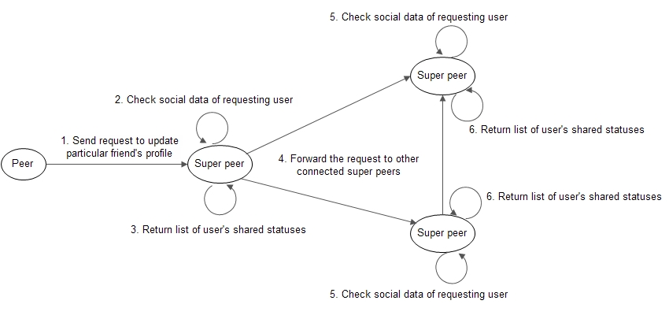
SYSTEM ARCHITECTURE PROPOSAL
3) Progresses in posting message service
c) Update particular friend’s profile progress
Notes:
Thirdly, Update particular friend’s profile progress: uses to update and keep tracks all shared statuses of a particular user.
A user sends requests to connecting super peer to update particular user’s profile.
Super peer receives the request and check list of storing files’ name whether the social data of requesting user are storing at database.
After that, if the super peer are storing these data of requesting user, it will return a response message to requesting user only including all of shared statuses of the requesting user. Inversely, if the super peer is not storing these data, step 4, 5 and 6 will be activated.
If the super peer is not storing these data, it will forward the request to other connecting super peers to help user keep tracks particular user’ statuses.
5, 6. In step 5 and 6 are the same with step 2 and 3 respectively.

Slide 12
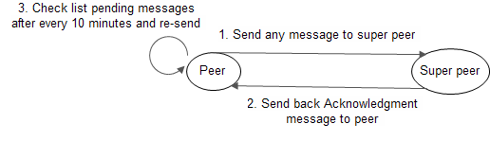
SYSTEM ARCHITECTURE PROPOSAL
3) Progresses in posting message service
d) Acknowledgment progress
Notes:
Latsly, Acknowledgment progress: used to confirm a super peers received the message. This is an activity to help peers avoid losing messages when they are sending a message to a super peer, which is unexpected shutdown.
A user sends a message to connecting super peer such as posting, like, comment messages, etc.
When a super peer has received the message, they will send back an acknowledgment message to requesting peer to notify they have received the message.
Step 3 will be launched after every 10 minutes in peer to check whether any messages are pending because they are not received by any super peers. After that, peer will re-send pending messages to connecting super peers.

Slide 13
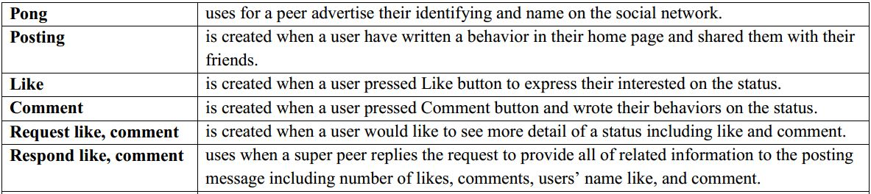
SYSTEM ARCHITECTURE PROPOSAL
4) Expanding Gnutella protocol
Ping messages remain unchanged with the original Gnutella protocol.
There are 11 new types of messages that need to be implemented to enable more efficient in posting message service.
Notes:
Pong: uses for a peer advertise their identifying and name on the social network.
Posting: is created when a user have written a status and shared it with their friends.
Like: is created when a user pressed Like button to express their interested on the status.
Comment: is created when a user pressed Comment button and wrote their behaviors on the status.
Request like, comment: is created when a user would like to see more detail of a status including like and comment.
Respond like, comment: uses when a super peer replies the request to provide all of related information to the posting message including number of likes, comments, users’ name like, and comment.

Slide 14
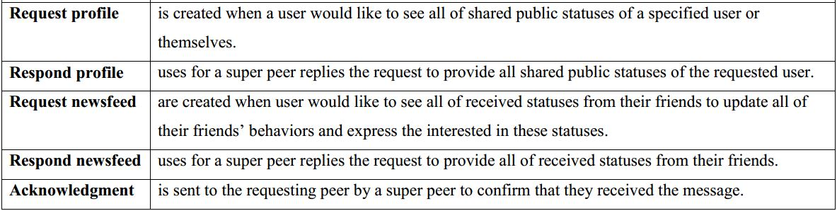
SYSTEM ARCHITECTURE PROPOSAL
4 – Expanding Gnutella protocol
Notes:
Request profile: is created when a user would like to see all of shared statuses of a particular user.
Respond profile: uses for a super peer replies the request to provide all shared public statuses of the requesting user.
Request newsfeed: are created when user would like to see all of received statuses from their friends to keep tracks their friends’ statuses and express their interested in these statuses.
Respond newsfeed: uses for a super peer replies the request to provide all of received statuses from their friends.
Acknowledgment: is sent to the requesting peer by a super peer to confirm that they received the message.

Slide 15
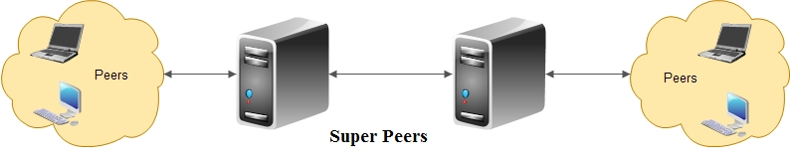
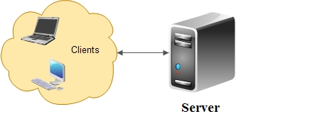
DEMONSTRATION
Topology
Posting message service on Super peer P2P architecture
Client-server architecture
Notes:
Now, Let’s move to the Demonstration.
We take a look on the topology of posting message service in the super peer P2P architecture to understand the demo easier.
This architecture are different with client-server. As you can see here.
In the video demonstration, we have a topology like this……
Let’s start the demo.

Slide 16
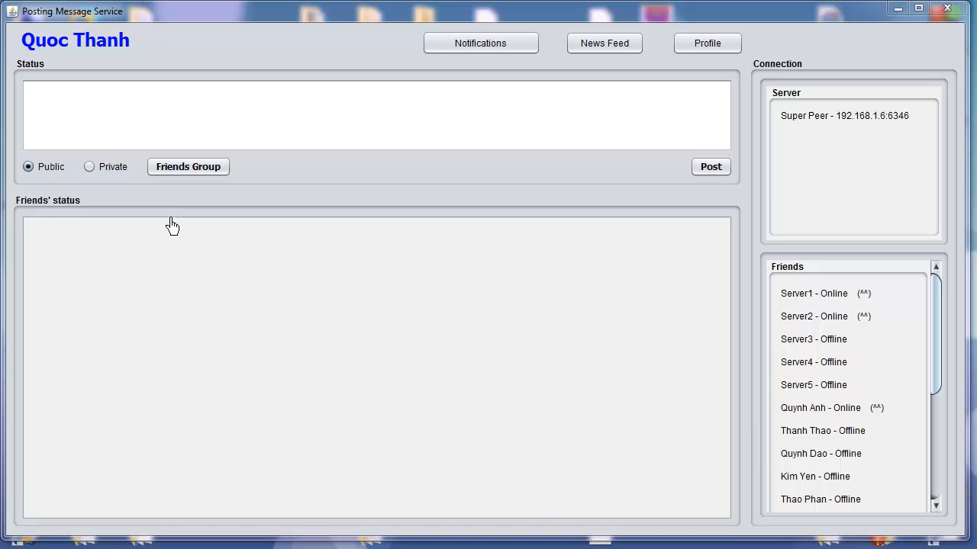
DEMONSTRATION

Slide 17
CONCLUSION AND FUTURE WORKS
Completed tasks:
Solved two main issues:
Privacy: allows users keeping personal data in their own device and manage the dissemination of personal data in the decentralized social network.
Storage: prevents single point of failure through super peers.
Retaining and expanding functionalities as Like, Comment, Notifications, Group Communication, etc. on posting message service.
Future works:
Associate with authentication service.
Adding some functions such as synchronization and encryption data, sharing photo, video, link or tagging, check-in location, making friends, etc.
Notes:
- Now, let me run over some key points again!
Completed tasks:
Solved two main issues:
Privacy: allows users keeping personal data in their own device and manage the dissemination of personal data in the decentralized social network.
Storage: prevents single point of failure through super peers.
Retaining and expanding functionalities as Like, Comment, Notifications, Group Communication, etc. on posting message service.
Future works:
Associate with authentication service.
Adding some functions such as synchronization and encryption data, sharing photo, video, link or tagging, check-in location, making friends, etc.

Slide 18
REFERENCES
Ha Manh Tran, Khoi DuyVo, Thanh Quoc Le, Thao Thi Thanh Phan. “Peer-to-Peer Based Social Network”. NICS conference: http://www.nafosted.gov.vn/nics2014/
H.M. Tran, K.V. Huynh, K.D. Vo, S.T. Le: Mobile Peer-to-Peer Approach for Social Computing Services in Distributed Environment. 4th International Symposium on Information and Communication Technology (SoICT 2013), DaNang City, Dec. 2013. ACM
B.Yangand H. Garcia-Molina. Designing a super peer network. InProc.19th International Conference on Data Engineering (ICDE’03), page 49, Los Alamitos, CA, USA, 2003. IEEE Computer Society.
Gnutella Protocol Specification version 0.4. http://rfc- gnutella.sourceforge. net/developer/stable/index.html, 2001. Last access in Mar. 2013.
J.A., Garbacki, P., Wang, Jun, Bakker, A., Yang, J., Iosup, A., Epema, D.H.J., Reinders, M.J.T., Steen, M. van & Sips, H.J. (2011). TRIBLER: a social-based peer-to-peer system. Concurrency and Computation: Practice & Experience, 20(2), 127-138. in Web of Science Cited
Sonja Buchegger, Doris Schiöberg, Le H. Vu, AnwitamanDatta. PeerSoN: P2P social networking: early experiences and insights. In SNS '09: Proceedings of the Second ACM EuroSys Workshop on Social Network Systems (2009), pp. 46-52, doi:10.1145/1578002.1578010
Decentralized Online Social Networks. Anwitaman Datta, Sonja Buchegger, Le Hung Vu,ThorstenStrufe,and Krzysztof Rzadca.
Stefan Saroui, P. Krishna Gummadi, and Steven D. Gribble. Measurement Study of Peer-to-Peer File Sharing Systems. Technical report, Department of Computer Science & Engineering, University of Washington, 2002.

Slide 19
THANK YOU
FOR
LISTENING

